Slide 1
American dream
"a term that expresses the ideals of democracy, equality and freedom and the belief that everyone has the opportunity to make a career and a fortune" - otherwise called a career from pucibut to millionaire.

Slide 2
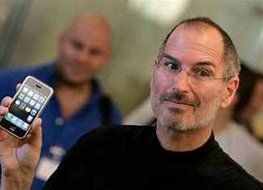
individualism
The values that U.S. residents profess in this matter have a significant impact on entrepreneurship in this country. This individual constantly striving to realize their own dreams is a fundamental and crucial element in creating a business.

Slide 3
Americans owe their strong individualism to the Puritan ethic. The whole of society has been organized to favor individuals, and at the same time American culture even encourages them to "give their all".

Slide 4
What do American managers do?
Have a special self-belief
Believing that thanks to their skills they will be able to overcome every log thrown under their feet.
The rules are not to be broken

Slide 5
The end

